Slide 1
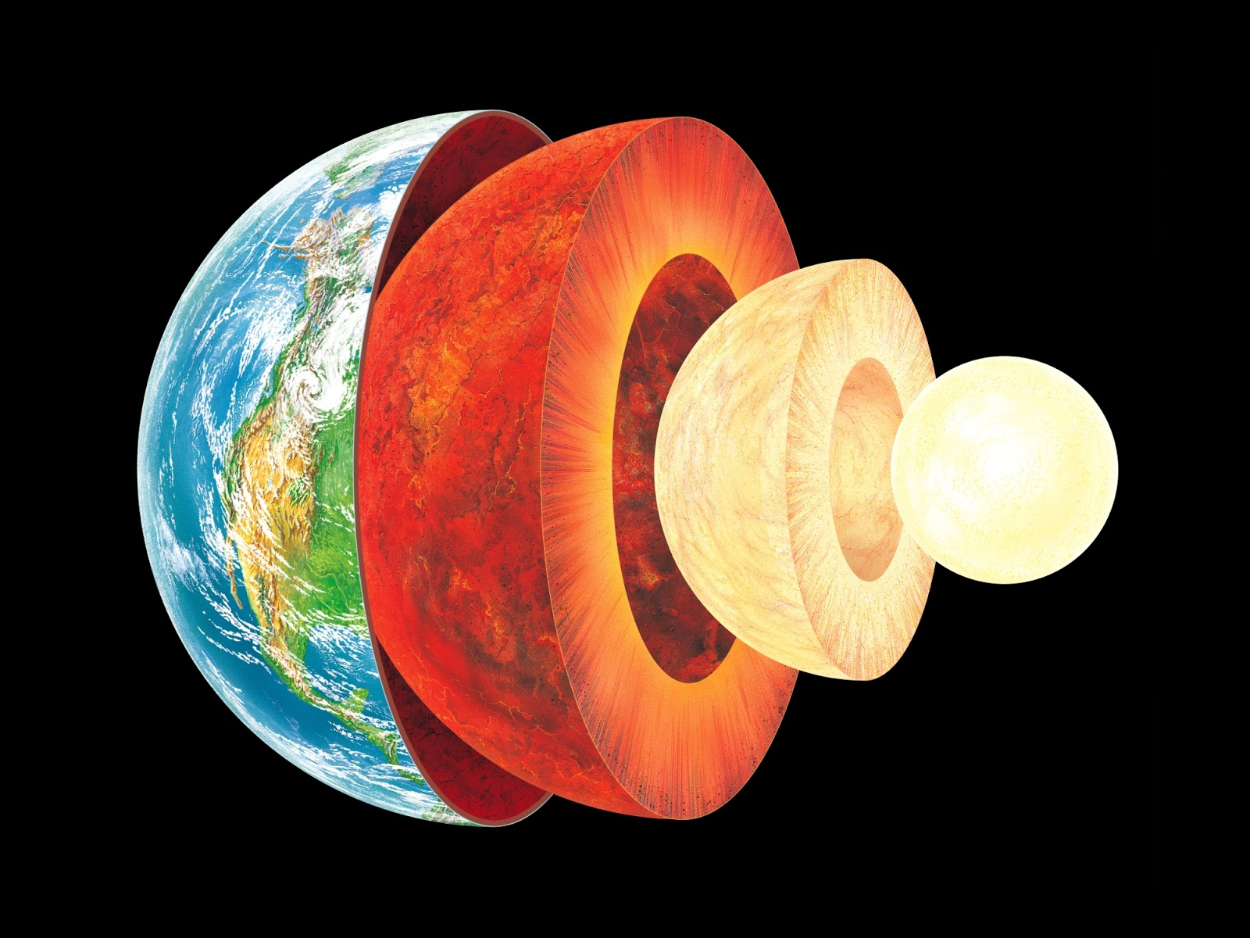
Layers of the Earth

Slide 2
Learning Objectives
I can describe the structure of the Earth’s interior.
I can relate the structure of the Earth’s interior to plate tectonics.
I can explain the convection currents that power plate movement.

Slide 3
Essential Question:
How are layers of the Earth different from one another?
Standard:
S6E5a. Compare and contrast the Earth’s crust, mantle, and core including temperature, density, and composition.

Slide 4
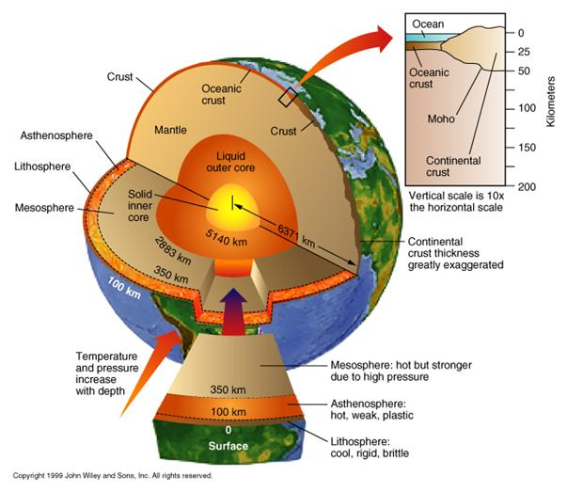

Slide 5
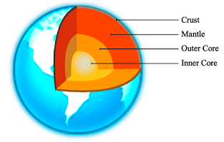
The Earth is made up of 4 main layers:
Crust
Mantle
Outer Core
Inner Core

Slide 6
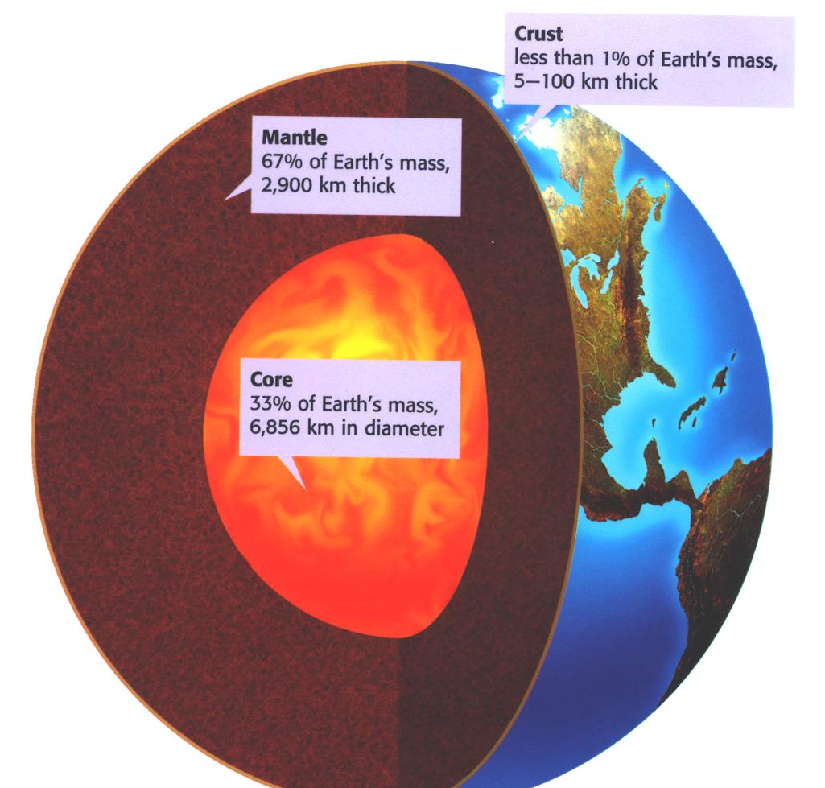
Basic Layers Percent of Earth’s mass
Crust
Mantle
Core

Slide 7
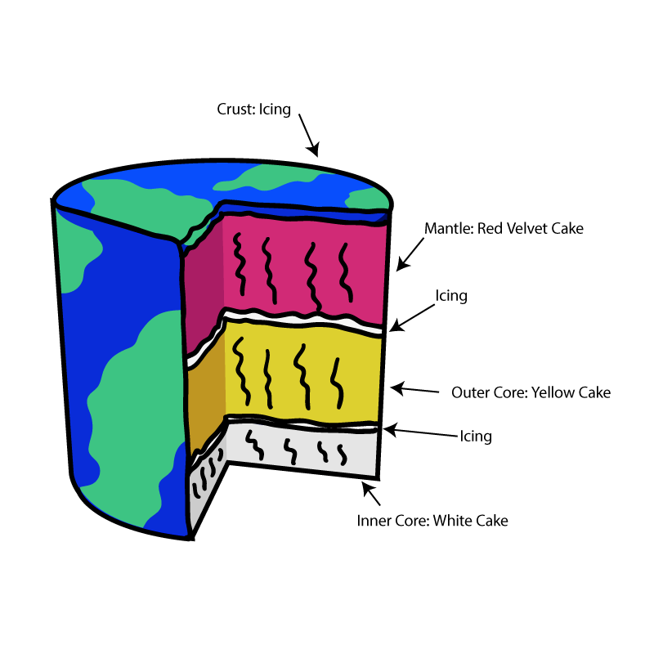
Think of the layers of the Earth like the layers of a cake.

Slide 8
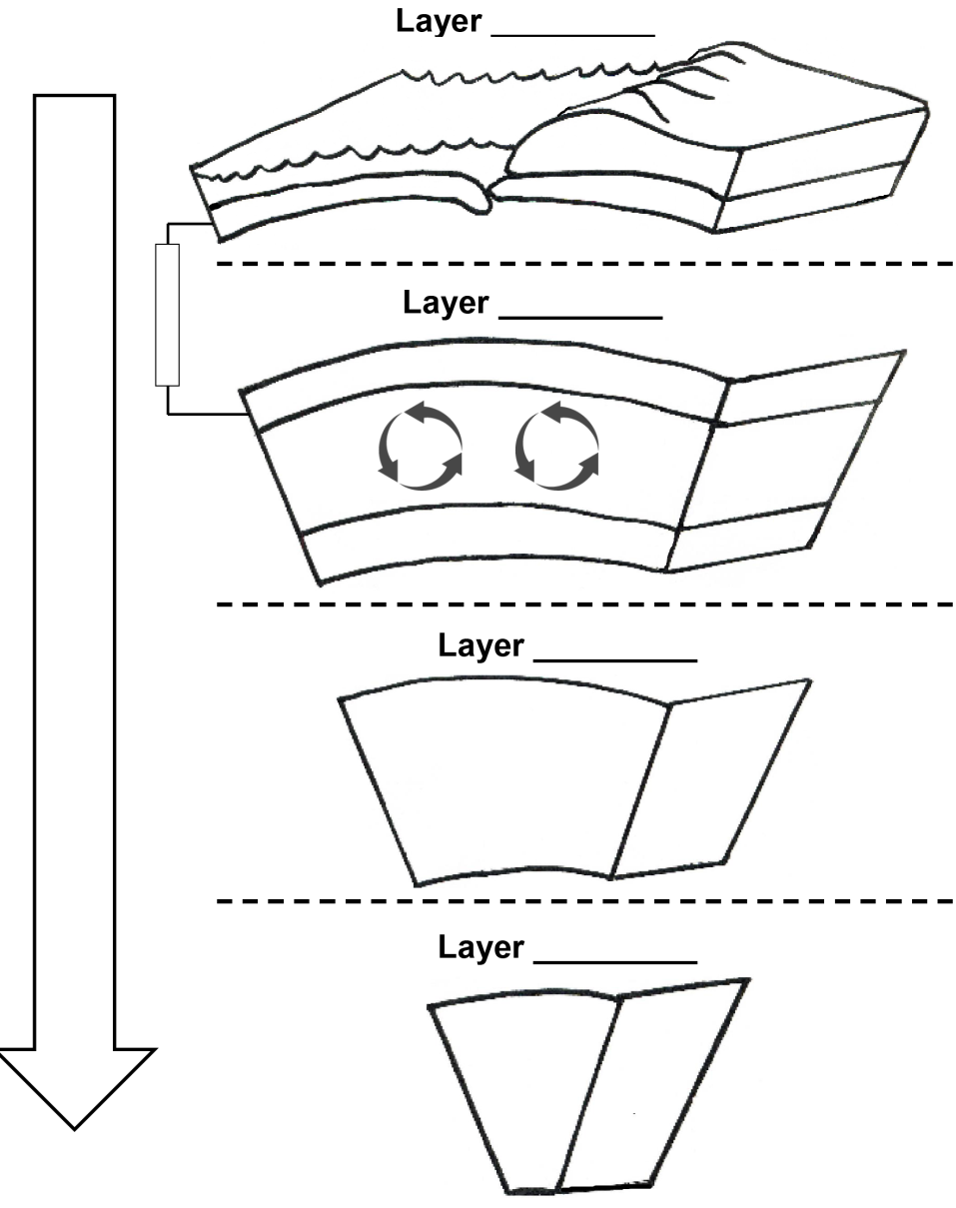
Use the Layers of the Earth Foldable to take notes

Slide 9
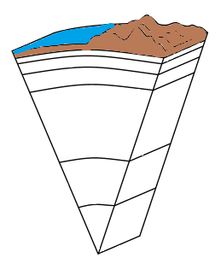
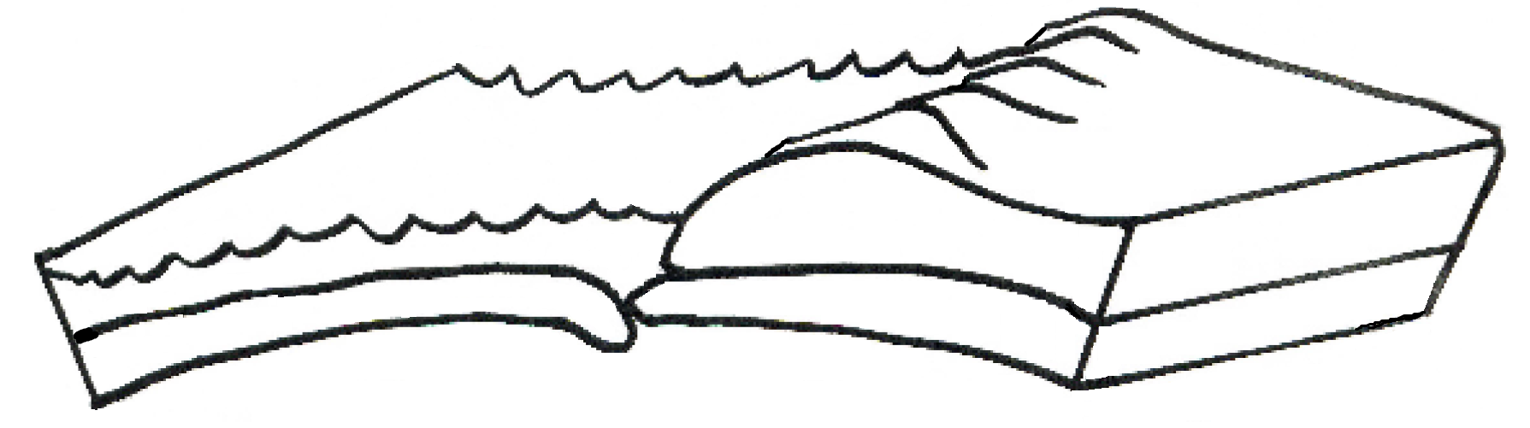
Crust
Ocean
Land
Oceanic Crust
Continental Crust

Slide 10

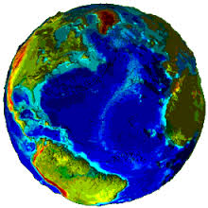
The Earth’s crust is like the skin of an apple.

Slide 11
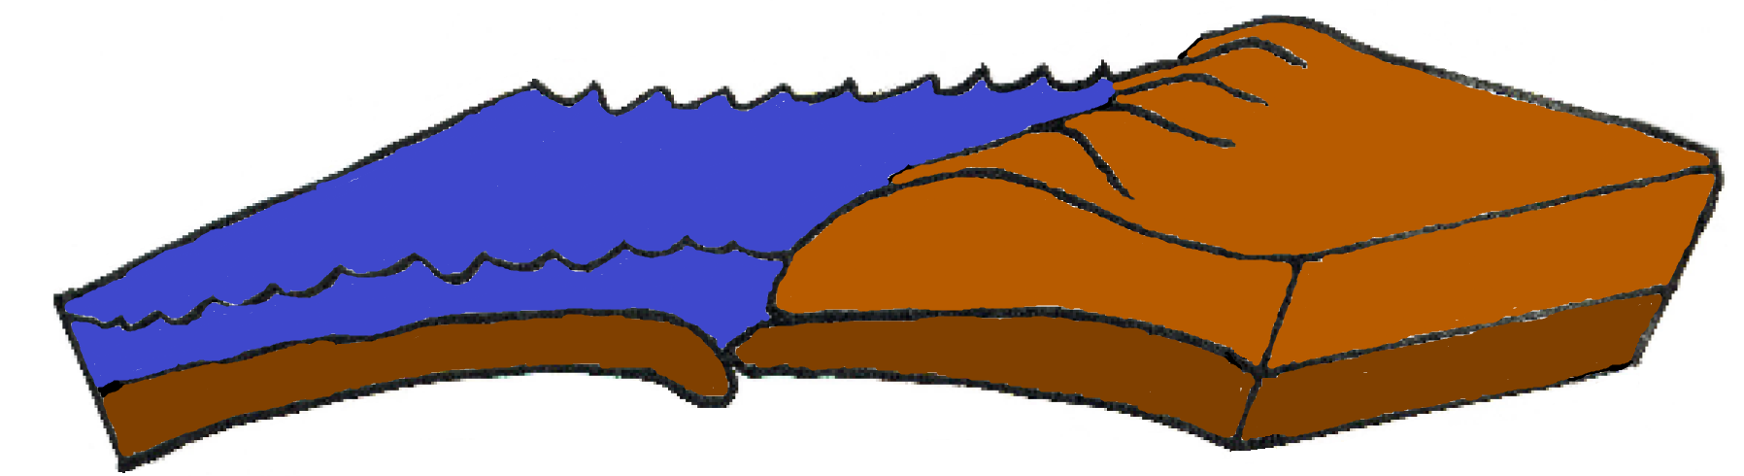
Crust
Ocean
Land
Oceanic Crust
Oceanic Crust
Continental Crust
Continental Crust
Thinnest layer of the Earth
Made up of large amounts of silicon and aluminum
Composed of plates on which the continents and oceans rest. These “ride” over molten mantle.
Crust is part of the lithosphere.
Two types of Crust: Oceanic and Continental
Notes:
In depth teaching about the plates and their movement will occur in the next essential question

Slide 12
Continental vs. Oceanic Crust
Category | Continental | Oceanic
Rock Type | Granite | Basalt
Thickness | 5 – 70km (Thicker) | 3 – 8 km (Thinner)
State | Solid | Solid
Crust Age | 4 billion years old or Older | 180 million years old or Younger
Density | Less Dense | More Dense
Element Composition | Oxygen, Sodium, Silicon, Aluminum, Potassium | Iron, Magnesium, Calcium

Slide 13
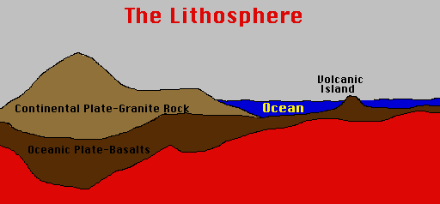
The Lithosphere
The crust and the upper layer of the mantle together make up a zone of rigid, brittle rock called the Lithosphere.

Slide 14
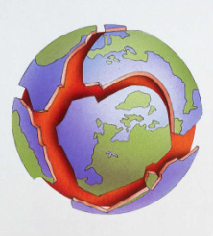
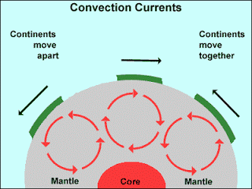
The lithosphere (crust and upper mantle) is divided into separate plates which move very slowly in response to the “convecting” part of the mantle.

Slide 15
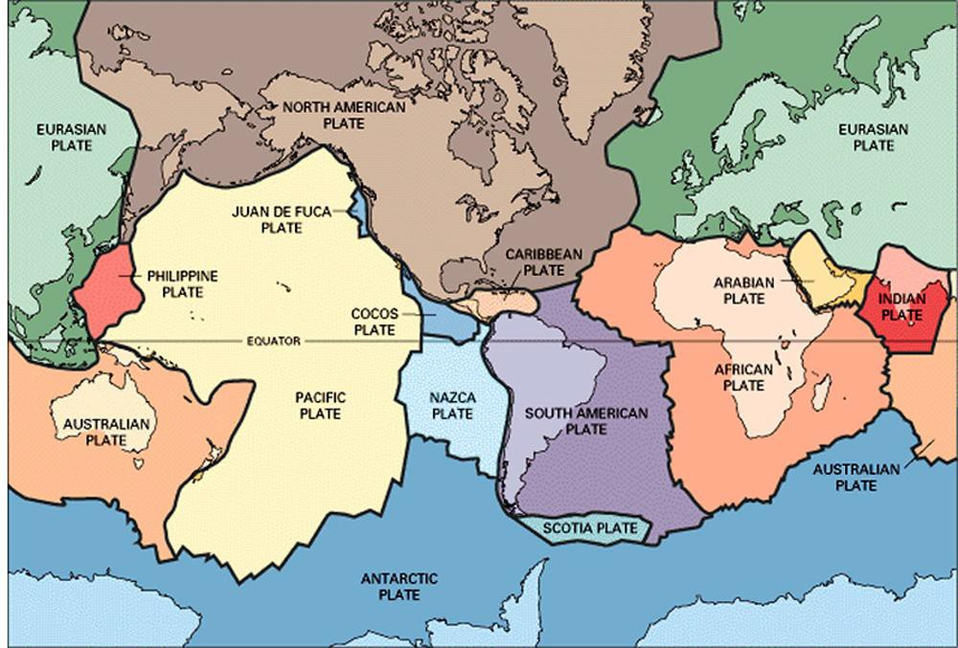
The Lithospheric Plates
The crust of the Earth is broken into many pieces called plates. The plates "float" on the soft, semi-rigid asthenosphere.

Slide 16
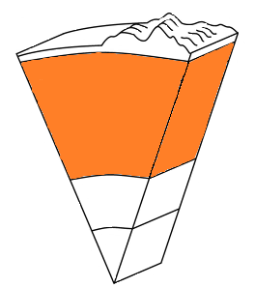
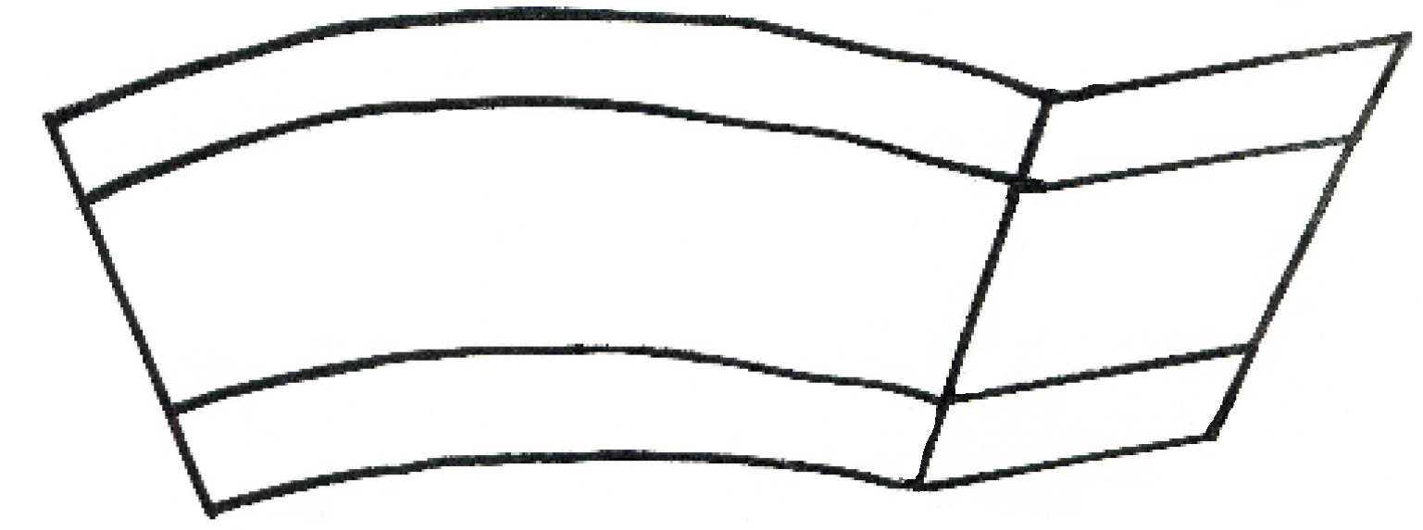

Mantle
Middle
Mantle
Upper Mantle
Convection
Currents
Lower Mantle

Slide 17
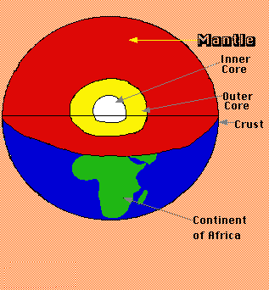
The Mantle
The Mantle is the largest layer of the Earth at 2900 km thick. The middle mantle is composed of very hot dense rock that flows like asphalt under a heavy weight. The movement of the middle mantle (asthenosphere) is the reason that the crustal plates of the Earth move.

Slide 18
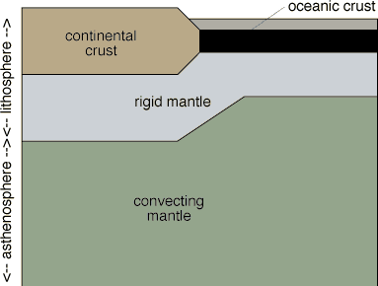
The Asthenosphere
The asthenosphere is the semi-rigid part of the middle mantle that flows like hot asphalt under a heavy weight.

Slide 19
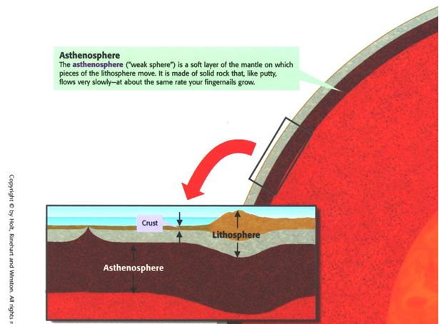
Asthenosphere
The asthenosphere (“weak sphere”) is a soft layer of the mantle on which pieces of the lithosphere move. It is made of solid rock that, like putty, flows slowly- at about the same rate your fingernails grow.

Slide 20
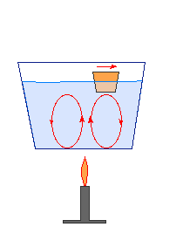
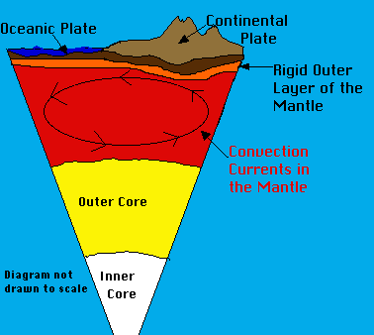
Convection Currents
The middle mantle "flows" because of convection currents. Convection currents are caused by the very hot material at the deepest part of the mantle rising being less dense, then cooling becoming more dense and sinking again --repeating this cycle over and over.

Slide 21
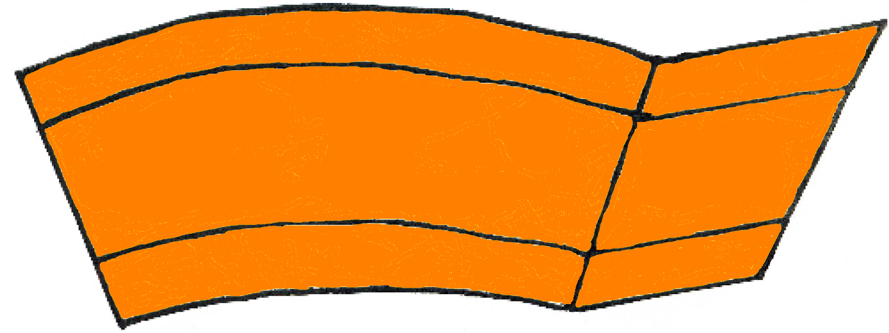
Mantle
Upper Mantle
Convection
Currents
Middle
Mantle
Lower Mantle
Solid but capable of flow (like fudge) Semi-Solid/Semi Liquid
Thickest layer of the Earth 2900km (1800 miles)
Element Composition: Magnesium, Silicon, Oxygen, and Iron
The hot magma rises then cools and sinks.
These convection currents cause changes in the Earth’s surface.
Conveyor belt for the tectonic plates.
Notes:
The movement of the lithospheric plates and the convection currents will be covered more in-depth during the next essential question.

Slide 22
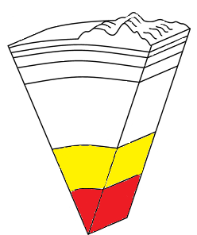

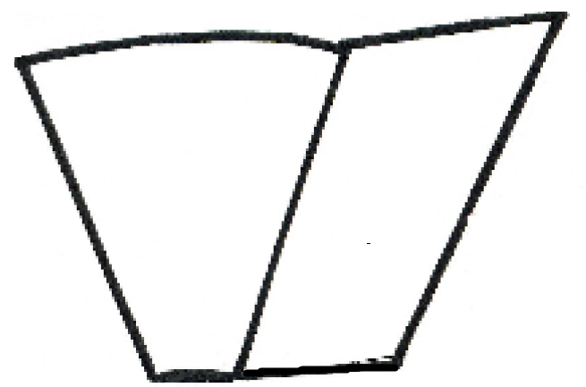
Core
Outer
Core
Inner
Core

Slide 23
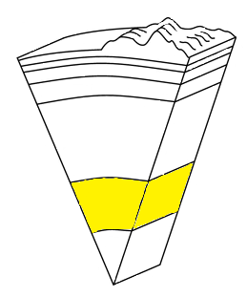

Outer
Core
Composition: Molten (liquid) metal that is about 4,700°C (8,500°F)
Thickness: 2,266 km (1,400) miles
State of Matter: Composed of the melted metals nickel and iron (liquid)
Located about 1,800 miles beneath the crust.

Slide 24

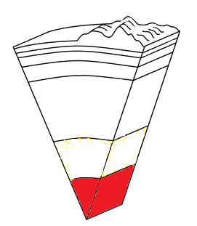
Inner
Core
Solid sphere made mostly of iron and has Nickel
It is believed to be as hot as 6,650°C (12,000°F)
Heat in the core generated by the radioactive decay of uranium and other elements
It is solid because of the pressure from the outer core, mantle, and crust compressing it.
Thickness: 1271 km (800 miles)

Slide 25
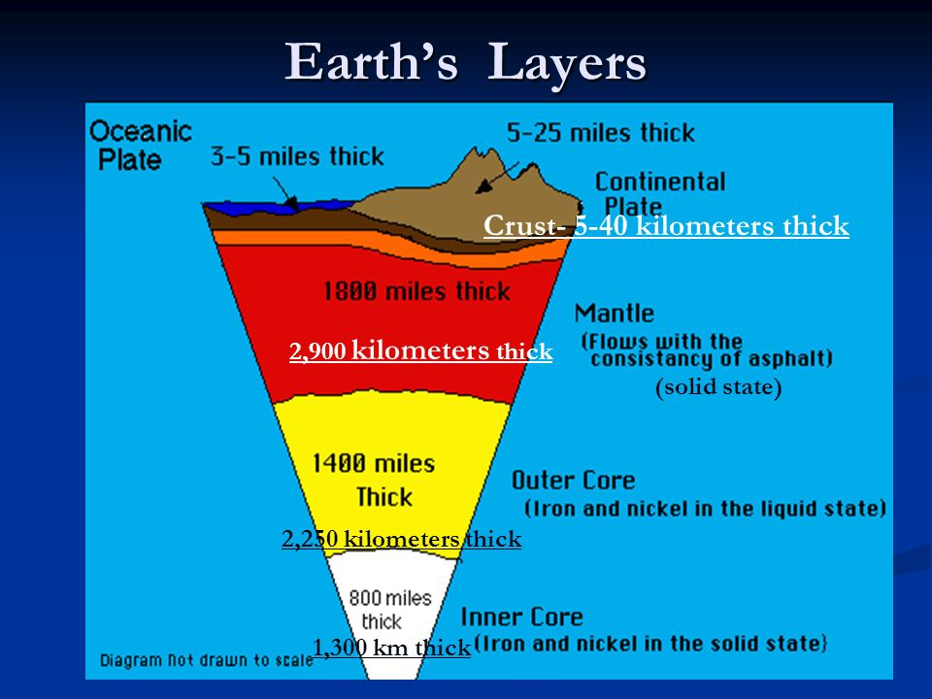

Slide 26
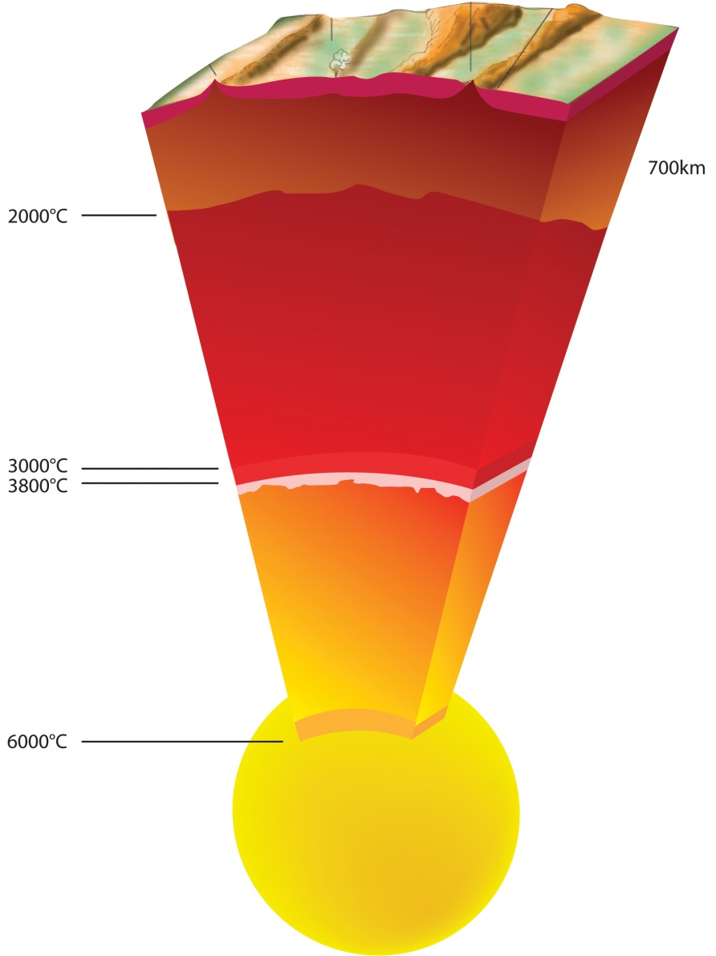
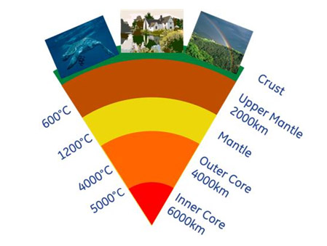
What do these two images tell us about the layers of the Earth?

Slide 27
Temperature increases as depth increases

Slide 28
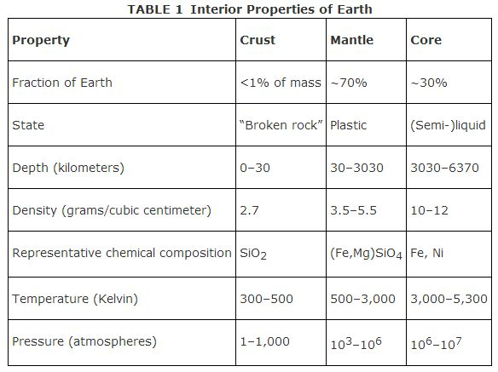
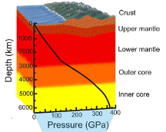
Look at the information in the graph and table below. What’s the relationship between depth and density/pressure?

Slide 29
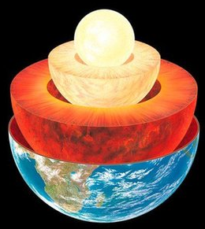
Density and Pressure increase as depth increases

Slide 30
Add this statement to the arrow going down on your foldable.
Temperature,
Density and Pressure increases as depth increases

Slide 31
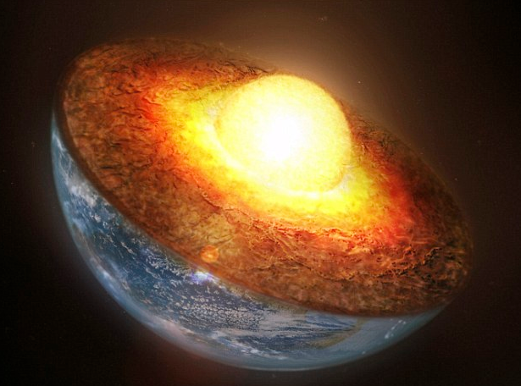
Which layer of the Earth has the greatest temperature, pressure, and density?
Core

Slide 32
How far have scientists drilled into the
earth?
  7.6 miles
– Only 0.2% of the distance to the earth’s
core

Slide 33
How do we know so much about
what’s under Earth’s surface?
Through INDIRECT EVIDENCE, mostly from seismic waves caused by earthquakes (more on this later this semester...)
Sometimes indirect evidence is the only option for scientists to develop a theory
Lets give it a try...

Slide 34
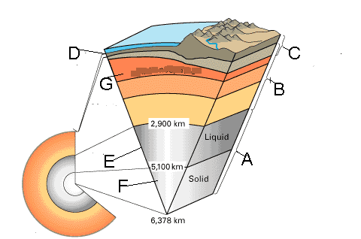
Practice Quiz Question
Can you label the following layers?

Slide 35
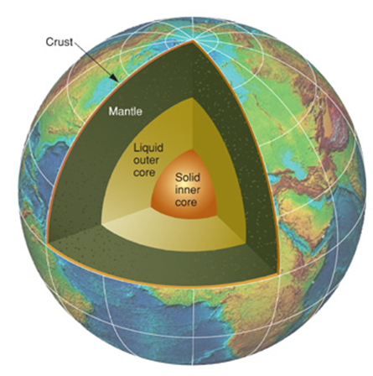
Earth’s Layers Rap
https://youtu.be/HOd7PRJMkkQ

Slide 36
Big Ideas
The Earth is divided into 3 Main Layers
  Crust
  Mantle
  Core
Main Rock type of the 2 types of Crust
  Oceanic – Basalt
  Continental – Granite
Oceanic Crust is denser than Continental Crust

Slide 37
Big Ideas Continued
The lithosphere is divided into tectonic plates.
The Mantle has the convection currents which causes the plates to move.
The Asthenosphere flows semi-liquid on which the plates move
Temperature, pressure, and density increases as depth increases. This is a direct relationship.

